Slide 1
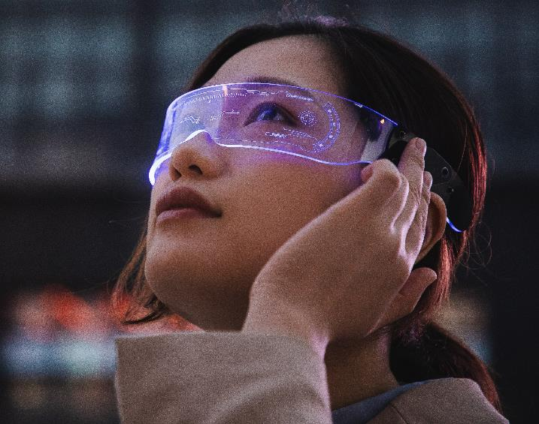
What is Metaverse
Haider ALi

Slide 2
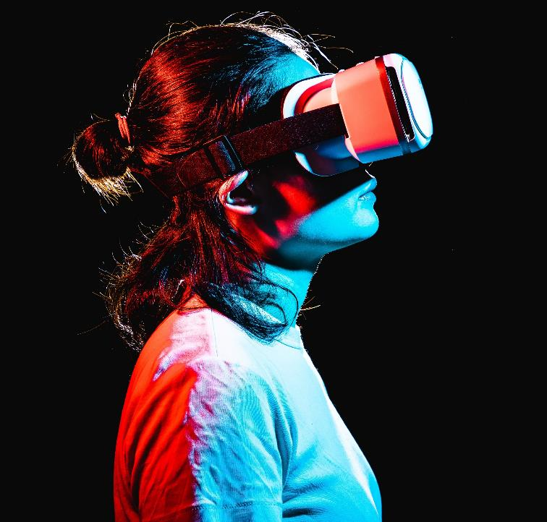
What is Metaverse
Metaverse is a virtual-reality space in which users can interact with a computer-generated environment and other users. Combination of augmented, virtual and mixed reality can be metaverse.

Slide 3
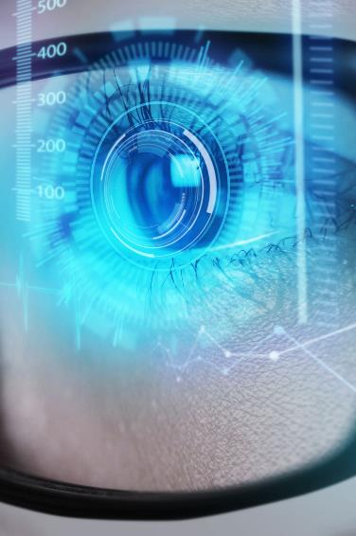
Where Did the concept come from
The term metaverse can be traced back to Neal Stephenson and his dystopian cyberpunk novel Snow Crash. Which describes a virtual reality dataspace called the matrix. Like any place in Reality, the Street is subject to development. Developers can build their own small streets feeding off of the main one. They can build buildings, parks, signs, as well as things that do not exist in Reality.

Slide 4
What you can Do in it.
Make a virtual property.
Earn money by investing in NFTs, play games etc.
Advertise anything.
Create an environment customized to yourself.
Own digital properties.
Buy and sell unique assets.
Express yourself through customizable avatars.
Socialize and make new friends.
Shop for real and virtual products.
Attend concerts, trade shows, and learning events.
Get a job in the metaverse.

Slide 5
Examples
Meta
Microsoft
Epic games
Vr chat
Meta envisions a virtual world where digital avatars connect through work, travel or entertainment using VR headsets.​
The software giant already uses holograms and is developing mixed and extended reality (XR) applications with its Microsoft Mesh platform, which combine the real world with augmented reality and virtual reality
The company that developed Fortnite, has said, "It's no secret that Epic is invested in building the metaverse
Vr chat is a game and it is a good example of how a metaverse may look like.

Slide 6
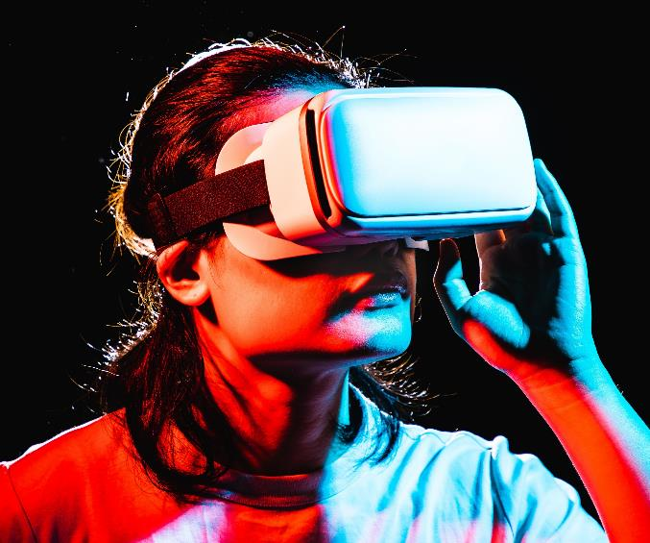
Pros $ Cons

Slide 7

Pros
Traveling the world without moving.
Increasing technological literacy and skills.
Connecting with new people without feeling awkward.
Creating completely new job opportunities

Slide 8
cons
Required of Advanced Digital Technologies.
Privacy and Security Implications.
Reducing the Difference between Real and Virtual

Slide 9

Meaningful Life in Metaverse
What makes your life meaningful? And are there any ways in which a virtual existence would get in the way of those things? There's a lot of factors in a meaningful life.
There's having significant goals and reaching them.
There's having positive relationships with other people.
There's having positive subjective experiences.
There's coming to understand things. But most of these basic kinds of things that matter, you ought to be able to get in a virtual world.

Slide 10
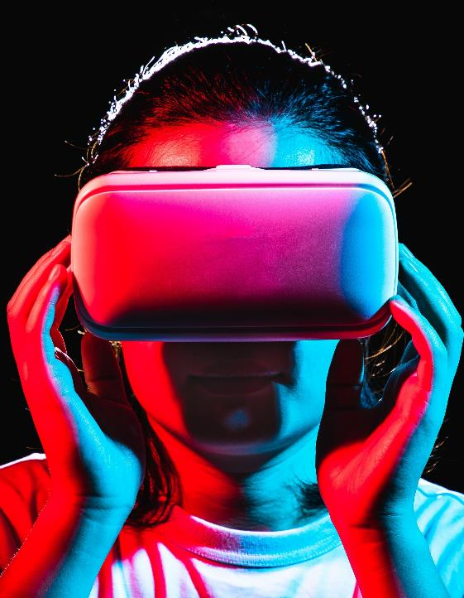
The Future of Metaverse
Today's metaverse : virtual reality as the "digital escape". Over the next few years the future metaverse would be something very similar to our real world in many aspects and even replace some real-world activities (like working or hanging out).
"A lot of people think that virtual reality is an illusion, that it's not real. But I say that it has causal power, it exists outside of our mind, and is not an illusion."

Slide 11

conclusion
Metaverse is the future of internet.
It has its own advantages and disadvantages.
Large companies taking a step forward it.
Two realities will exist.

Slide 12
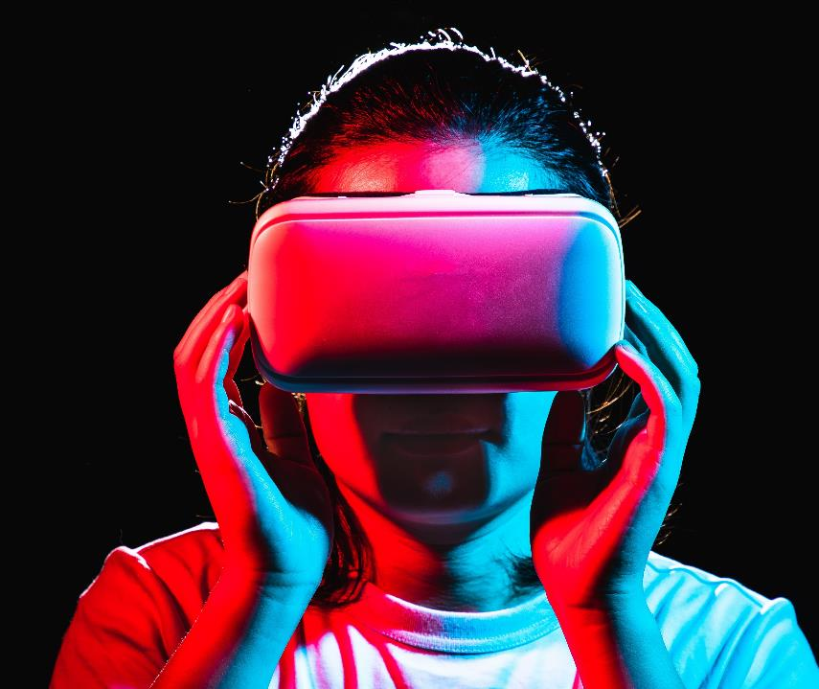
Thank you

